Slide 1


Azure SQL Database
Trusted Data Platform for all Workloads
Joachim Hammer
Principal Program Manager
Database Systems Group
Joachim.Hammer@microsoft.com

Slide 2
What Customers Want from SQL Database (in no particular order)
Need to deal with massive data growth
Lift-and-shift to the cloud
Consistent experience across the entire SQL platform
App development
Maintenance, troubleshooting
Simple to configure and manage (at scale)
Provide state-of-the-art security to protect against the latest threats
…

Slide 3
Areas of Innovation
Learning @ Adaptation
Performance and Scale
Security & Data Protection
Enhance Developer Productivity

Slide 4

Azure SQL Database
Fully managed SQL database service
Predictable performance & pricing
Elastic database pool for unpredictable SaaS workloads
99.99% availability built-in
Geo-replication and restore services for data protection
Secure and compliant for your sensitive data
Fully compatible with SQL Server 2017 databases
Azure
SQL Database
DB

Slide 5
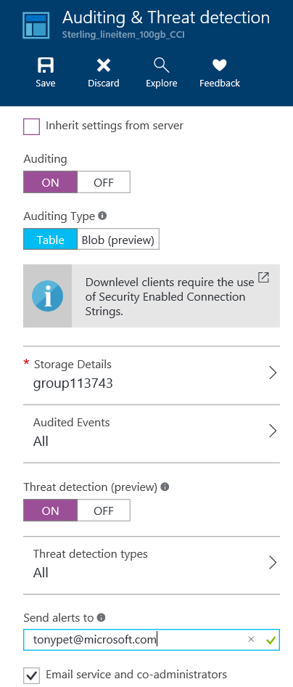
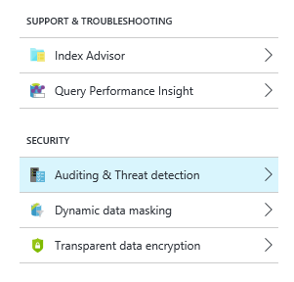
Performance insight
Index advisor
Anomaly detection
Azure SQL Database Learns and Adapts

Slide 6
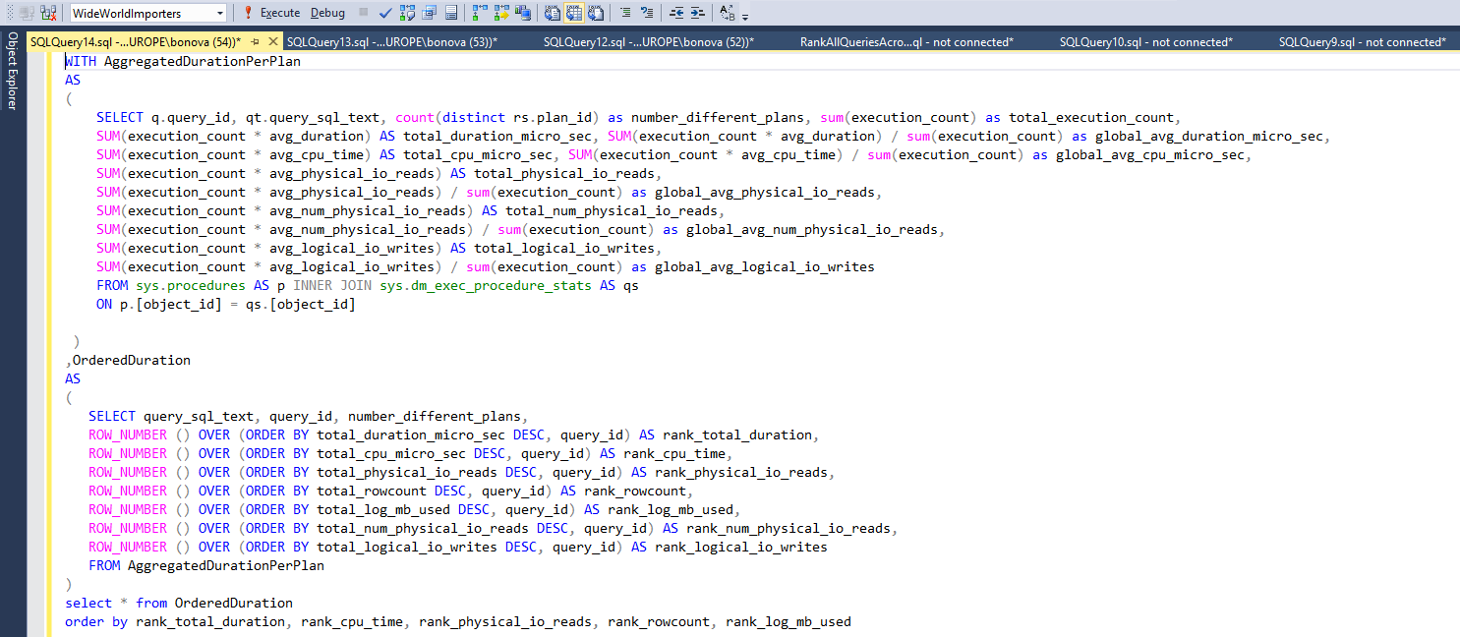
What is hard about troubleshooting?
Users are typically not prepared
Performance data is not available when needed
(“I should’ve been taking snapshots before…”)
Result: times to detect and to mitigate are long
DMVs: wait for problems to happen again
What if statement is not cached?
XEvents: how to use?
Which events to track, how long, how to interpret results?
Finally, I’ve pinpointed the regression!
But now: How to force a better plan?
Complex
Error prone
Slow

Slide 7

A Better Way: Query Performance Insight
Performance Insights and Recommendations
Deeper insight into database resource (DTU) consumption
The top queries by CPU/Duration/Execution count, which can potentially be tuned for improved performance
Ability to drill down into the details of a query, view its text and history of resource utilization
Performance tuning annotations that show actions performed by SQL Azure Database Advisor
SQL Database
Query Performance Insight
Compile
Plan Store
Execute
Runtime Stats
Query Store Schema
Asynchronous Write-Back

Slide 8
Resumable Index Operations
Adaptive Query Processing
More Storage, more flexible performance tiers, faster resizing
Performance and Scale

Slide 9
Resumable Index Operations
To enable a resumable online index rebuild on a clustered index
ALTER INDEX IdxTest on BigTable REBUILD WITH (ONLINE=ON, RESUMABLE=ON, MAXDOP=1)
Go
<Pause the indexing operation, e.g.,
Cancel in SSMS or Ctrl-C in cmd tool>
Execute the same command to resume the paused index
ALTER INDEX IdxTest on BigTable REBUILD WITH (ONLINE=ON, RESUMABLE=ON, MAXDOP=1)
Go
Adapt to outages without losing maintenance work
Resume an index rebuild operation after an unexpected failure
Pause and resume an index build operation at any time, for example, to temporarily free up systems resources in order to execute a high priority task
Supports rebuilding large indexes online without requiring significant log space, allowing log truncation while rebuild operation is running

Slide 10
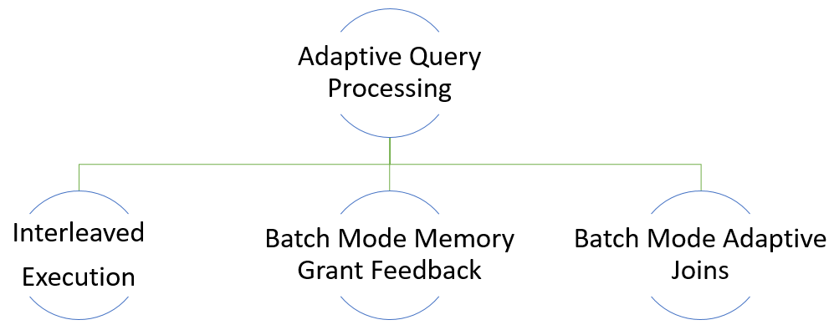
Adaptive Query Processing Family

Slide 11

Interleaved Execution
Pre 2017
Optimize
Execute
Problem: Multi-statement table valued functions (MSTVFs) are treated as a black box by QP and we use a fixed optimization guess
Interleaved Execution will materialize row counts for multi-statement table valued functions (MSTVFs)
Downstream operations will benefit from the corrected MSTVF cardinality estimate
100 rows guessed for
MSTVFs
Performance issues if skewed!
2017+
MSTVF
identified
Execute
MSTVF
500k rows
assumed
Good
Performance!

Slide 12
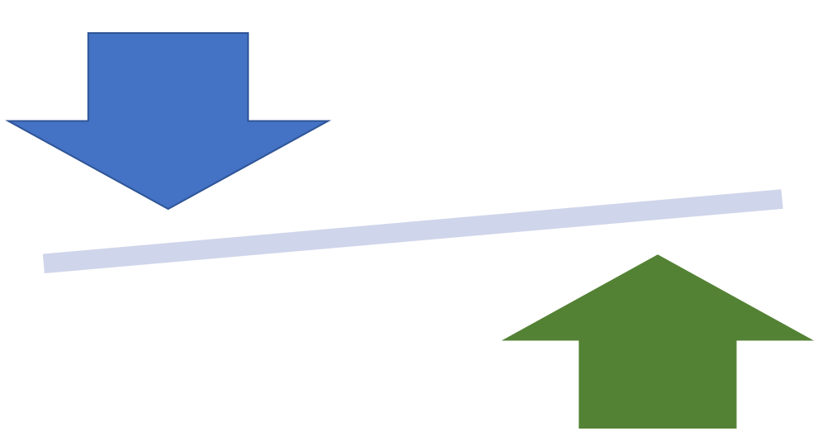
Batch Mode Memory Grant Feedback
Problem: Queries may spill to disk or take too much memory based on poor cardinality estimates
MGF will adjust memory grants based on execution feedback
MGF will remove spills and improve concurrency for repeating queries

Slide 13
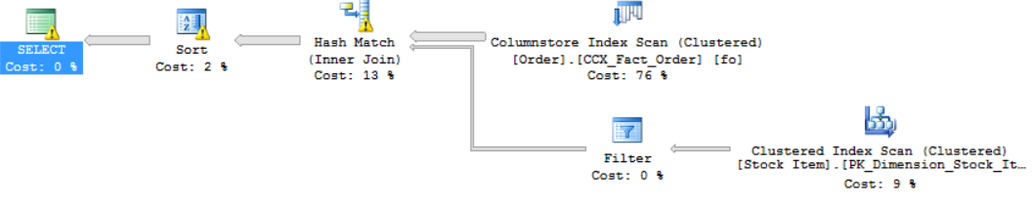
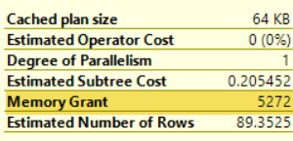
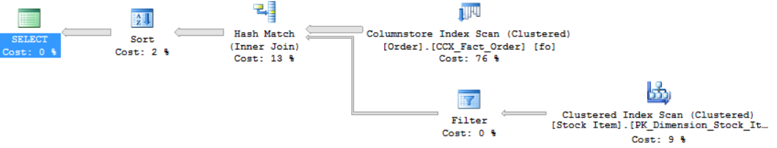
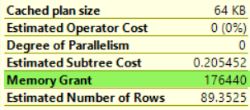
Batch Mode Memory Grant Feedback
Before
Spill
Spill
Spill detected
and feedback generated
After

Slide 14
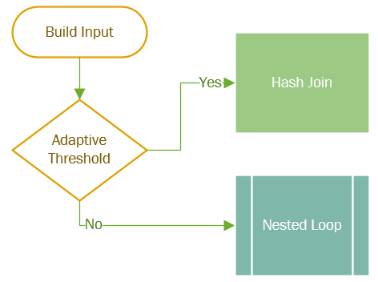
Batch Mode Adaptive Joins
Problem: If cardinality estimates are skewed, we may choose an inappropriate join algorithm
AJ will defer the choice of hash join or nested loop until after the first join input has been scanned
AJ uses nested loop for small inputs, hash joins for large inputs

Slide 15
Security & Data Protection
State-of-the-art security toolkit to implement layered security strategy
Built-in
Easy-to-use
Require only minimal changes to app code
Available across all platforms
Example:
Always Encrypted

Slide 16


Security in Layers
Protect data
Encryption at rest Transparent data encryption
Backup encryption
Cell-level encryption
Encryption in transit Transport Layer Security (TLS 1.2)
Client-side encryption Always Encrypted
Control access
Database access SQL authentication
Active Directory authentication
Granular permissions
Application access Row-Level Security Dynamic Data Masking
Monitor access
Tracking activities Fine-grained audit

Slide 17
Client-side encryption
Scenario
Solution: Always Encrypted
Need to store sensitive data (e.g. SSN, DOB, address, or other PII)
But must prevent high-privileged sysadmins from being able to access it
Data encrypted by master key stored outside SQL Server
Always Encrypted client drivers handle encryption for you
e.g. ODBC, JDBC, ADO.NET
Easier than alternatives:
Buy a third-party solution
Write custom app code (risky & expensive)
Docs: https://docs.microsoft.com/sql/relational-databases/security/encryption/always-encrypted-database-engine

Slide 18

Client-side encryption
Always Encrypted: How it works
trust boundary
SQL Server
Client
"SELECT Name FROM Customers WHERE SSN = @SSN","111-22-3333"
Enhanced Client Driver
"SELECT Name FROM Customers WHERE SSN = @SSN",0x7ff654ae6d
ciphertext
Result Set
Result Set
Name
Wayne Jefferson
Name
0x19ca706fbd9a
dbo.Customers
Name | SSN | Country
0x19ca706fbd9a | 0x7ff654ae6d | USA
ciphertext

Slide 19
Enhance Developer Productivity
Works with popular languages
Works in popular platforms
Improve productivity with management portal and REST APIs
Example:
T-SQL Extensions for Graph Support v1

Slide 20

Your choice of language and tooling
SQL Server Azure SQL Database SQL DW
ADO.NET
JDBC
ODBC
ODBC
FreeTDS
ODBC
Tedious Node.js Driver
FreeTDS
FreeTDS
PHP Driver
db-lib
Node.js Driver
Pymssql
Pymssql
TinyTDS
TinyTDS
Django
Rails
C#
VB.NET
Java
C/C++
PHP
JavaScript
Python
Ruby

Slide 21
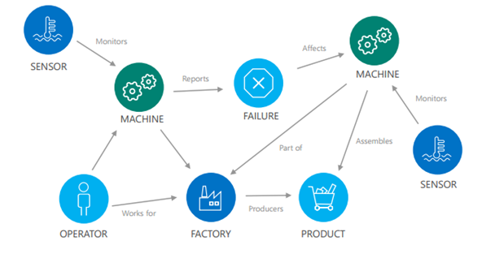
Graph Database Scenarios
Represent hierarchical or interconnected data with complex relationships
Accommodate many-to-many relationships
Allow for evolving requirements - organically growing connections as the business evolves
Easily analyze interconnected data, materialize new information from existing facts and identify non-obvious connections
Nodes: Entities – for example, machines, sensors, products
Edges: Relationships between nodes, lines that connect nodes to other nodes
Properties or Attributes: information associated with specific nodes and edges

Slide 22
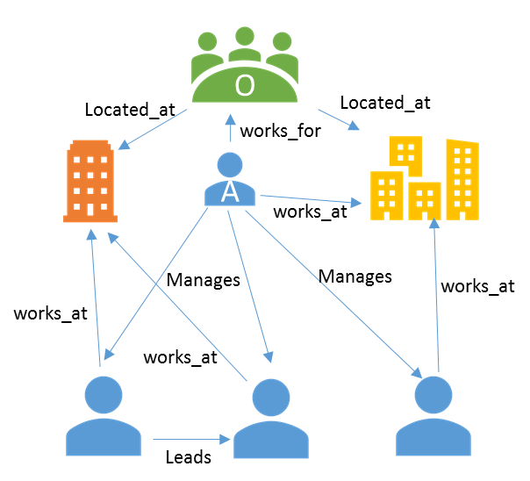
Query Language Extensions
Native nodes and edge table support
Query language extension provides multi-hop navigation using join-free pattern matching
Query across regular SQL tables and graph data
CREATE TABLE AccountHolder (FirstName varchar(50), … ) AS NODE
…
CREATE TABLE works_at AS EDGE
SELECT p2.name
FROM Person, Manages,
Person Person2,
works_at,
location
WHERE
MATCH(Person-(Manages)->Person2-(works_at)->location)
AND Person.name = ‘Shreya’
AND location.name = ‘Seattle’

Slide 23
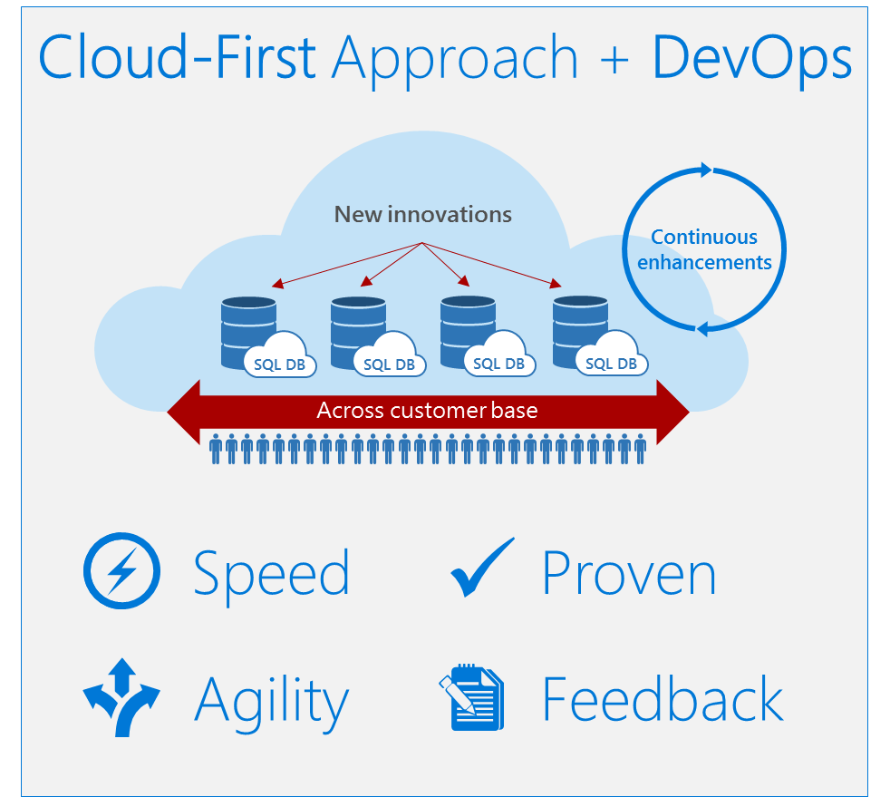

Family of Managed RDBMS Services in Azure
SQL Database Managed Instance
SQL Database
SQL
DB
SQL Data Warehouse
Database for PostgreSQL/
MySQL
SQL Server in Azure VM
DW

